Slide 1
Traffic Sign
Detection
By:-
171FA04007
171FA04023
171FA04554
171FA04556

Slide 2
Index
Abstract
01
Theme of our project
Problem description
02
The use of project compared to others and future scope
Requirements/pre-requisites
03
Software and hardware requirements
Applications and challenges
04
The usage of our project in various aspects and challenges we might face

Slide 3
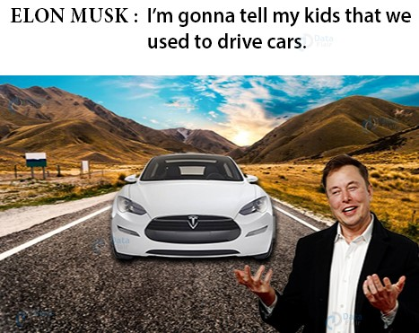
Introduction
You must have heard about the self-driving cars in which the passenger can fully depend on the car for traveling. But to achieve level 5 autonomous, it is necessary for vehicles to understand and follow all traffic rules.
In the world of Artificial Intelligence and advancement in technologies, many researchers and big companies
like Tesla, Uber, Google, Mercedes-Benz, Toyota, Ford, Audi, etc are working on autonomous vehicles and self-driving cars. So, for achieving accuracy in this technology, the vehicles should be able to interpret traffic signs and make decisions accordingly.

Slide 4
There are several different types of traffic signs like speed limits, no entry, traffic signals, turn left or right, children crossing, no passing of heavy vehicles, etc. Traffic signs classification is the process of identifying which class a traffic sign belongs to.
In this Python project example, we will build a deep neural network model that can classify traffic signs present in the image into different categories. With this model, we are able to read and understand traffic signs which are a very important task for all autonomous vehicles.
Problem Description

Slide 5
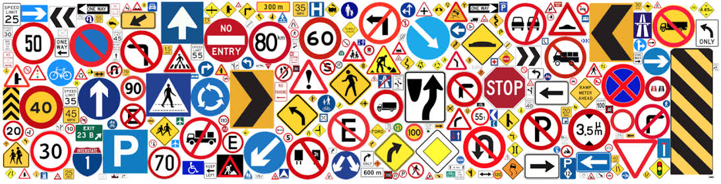
Traffic sign dataset from kaggle
The dataset contains more than 50,000 images of different traffic signs. It is further classified into 43 different classes. The dataset is quite varying, some of the classes have many images while some classes have few images. The size of the dataset is around 300 MB.

Slide 6
Requirements(minimum)
4GB RAM
i5 processor
Windows 7+
Might work on linux and mac but gpu support is not easy
Tensorflow backend
Webcam (optinal)
Miniconda or anaconda
Jupyter notebook
Atom or pycharm
Object detection
Python 3.6(3.7 not supported)
Open-cv
Keras
Scikit-learn
Tkinter
Pandas
Matplotlib
Nvidea GPU
.

Slide 7
The traffic sign recognition can be used in automated vehicles to provide driverless or auto drive modes. This
Will reduce human efforts in heavy
Traffic or continuous journey..But the
System has to be accurate enough
To avoid any disasters..The goal is to build a model with 95% accuracy to make sure that traffic signs get
identified in any cases whether it
Might be a foggy weather or dusted
Sign.This system can also be used
For driver assistance where as few
Traffic signs are confusing and most
Of the people don’t even know the
Meaning.
Applications
and
challenges

Slide 8
Thank you

